Slide 1

Best deals on old cars
Presented by – prateek sharma
Divyanshu
shruti

Slide 2
User friendly
Easy
Automate
Link

Slide 3
aim
Due to rapid growth of technology , We have switched over from the traditional method of selling and buying goods to electronic method . But due to availability of so much of data traffic on those heavy E-commerce sites. It is hard to find out best deals by comparing all at once. It is time consuming and very hectic too. So, to organize that manual task this project was aimed which will automatically serves you its best results.

Slide 4
objective
The objective of this project is to
1. Automate the manual task of humans.
2. Automatically browse through different E-commerce sites and scrap the required data from them.
3. Make a documentation of that scrapped data.
4. Sort that data and extract the best deal out of it.
5. Notify the user about that deal by sending a mail containing the details of the product and link to payment.

Slide 5
Scope of the Project:
India is on the verge of being the most powerful country because of this pandemic everyone is trying to boycott china and their products which has made an oppurtunity for india to become technologically developed and somehow these kinds of projects marks a start to it therefore this project will surely has huge scope.
Successful projects are ones that take into account the satisfaction of the customer. Whether they meet the customers expectations and accept the product, service or process. After the development of this project ,we adhere to the fundamental of "Get more done in less time". Achieving the success of this project will save time as well as money .

Slide 6
Feasibility study
1. TECHNICAL FEASIBILITY:-
Our project is a UIPATH studio based automated project. The main technology and tools that are associated with our project are- uipath studio,E-mail,Browser etc. Each of the technologies are freely available on the internet. The technical skills that are required are managable. Time limitations of the project development and the ease of implementing using these technologies are synchronized. From these it's clear that our project is technical feasible.

Slide 7
2 Financial Feasibility:
All the software associated with this project are freely available . Also bandwidth requirement for this project is very low. No additional charges or costs are applied to this project. Hence, it is financially feasible.

Slide 8
3 Market Feasibility:
Since the online market makes a huge impact in today's world where a billions of customers are rendering day and night to buy some or the other things. This project can help them to extract the best deals that are available for their products. Hence, this project will be impactful in the market and hence market feasible too.

Slide 9
Stakeholders
Internal stakeholders
Students
Project lead
Project manager
Investors
External Stakeholder
Customers
Suppliers

Slide 10
REQUIREMENT ANALYSIS REPORT
1: Requirement Gathering:
To serve the purpose of this project we need a software which automate all of the processes required in simpler and efficient manner. UiPath, a RPA software helps us in deploying our project . So, basically what we need is that when user gives his input , the robot automatically search that input on multiple websites . It must keep a record of items and give the best deal to his client. We must also make it user friendly so that the client doesn’t have any doubts in the working and also it is easier for them to choose correctly.

Slide 11
2. Requirement Analysis :
So, what we have analyzed that if a person want something to buy through online E-commerce sites ,he\she has to waste a lot of time in digging those sites. The traditional way which is followed by most of us is going to a particular website , type your requirements in the search bar and keep on scrolling till we find the required items. But the real problem lies when we got to know that the item on a particular site is way more costlier than some other websites and ultimately it is a loss to time and money. So, for that purpose we turn out with a idea --How about if a Robot do all of this for us and help us to save our money and time??

Slide 12
3 Requirement Specification:
Our project deals with a process known as Robotic Process Automation. RPA , a tool which is an emerging technology to eliminate tedious tasks, freeing corporate workers to focus on higher value work. But RPA requires proper design, planning and governance if it's to bolster the business, experts say.So,focussing on each aspect of requirements we have designed this project to work in its full potential . Our main focus is to provide a better user experience and also keep the safety of users confidential data .And regarding its performance , a client can aspect a total human intervention free process which is fully automated and also can be altered as per human requirements.

Slide 13
Non-Functional Requirements:
1.The project shall take load time depending on internet connection strength which also depends on the media from which the project is run.
2.The performance shall depend upon system specifications of the client.
3. Limited numbers search queries for the users.
4. Limited number of websites are added.
5. It will consume a bit of memory for storing details of sorted items in a spread sheets.

Slide 14
Software Requirements:
1. Windows 7 or above is required OS, though recommended is Windows 10.
2. .NET framework 4.6.1 is minimum required. 3.7
Hardware Requirements:
1. CPU with 1.4 GHz 32-bit is minimum required and Dual Core 1.8 GHz 64-bit is what recommended.
2. Similarly, for RAM, 4 GB is what the minimum requirement is while 8 GB is the recommended RAM.
Resource requirement
1. A UiPath software application is required.
2. A browser to search.

Slide 15
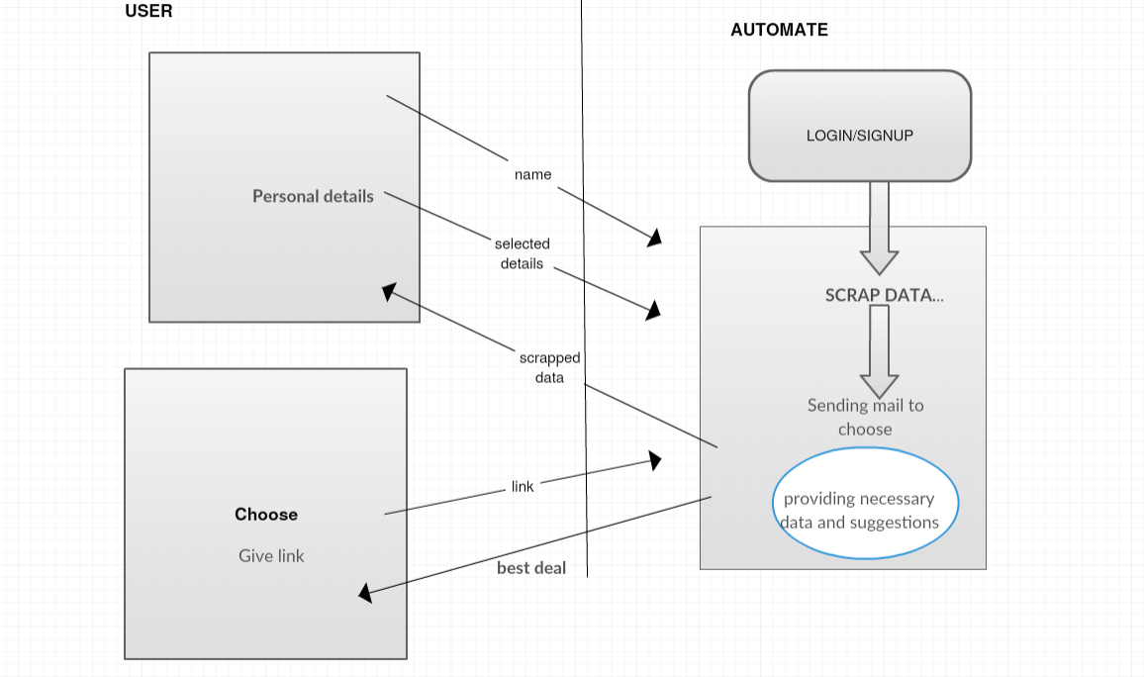
HIGH LEVEL DIAGRAM

Slide 16
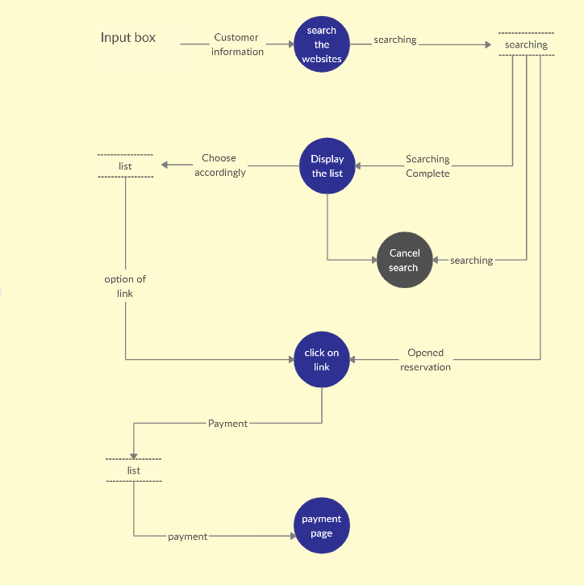
DFD diagram
searching
login/signup

Slide 17
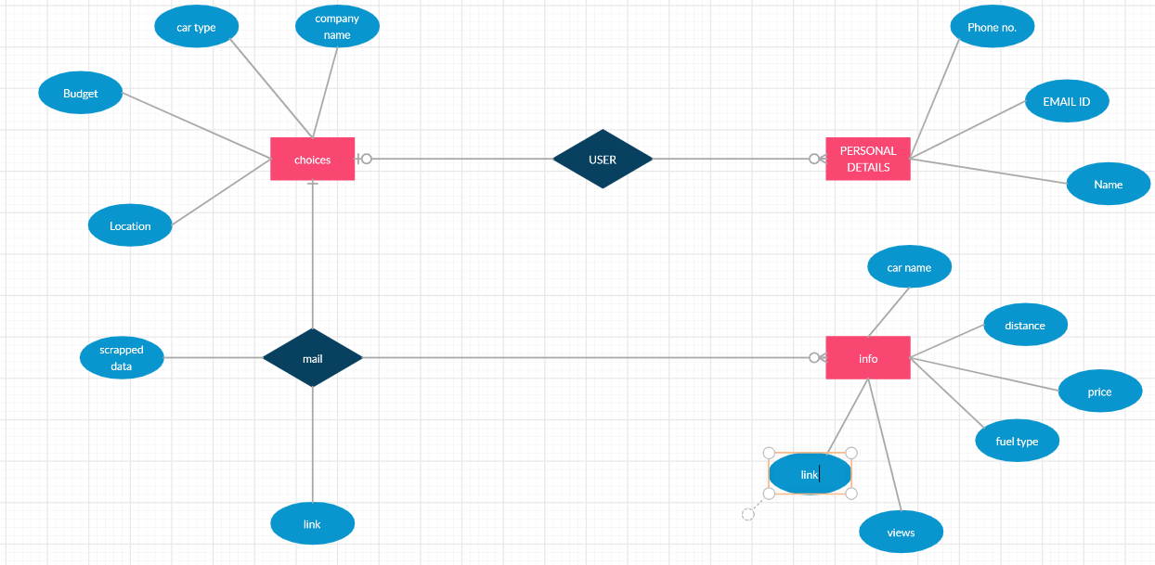
e/r diagram

Slide 18
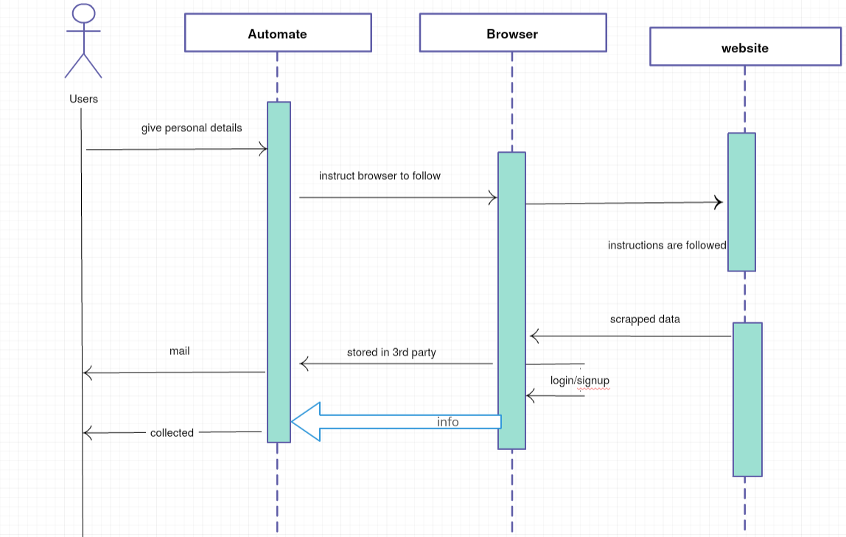
Sequence diagram

Slide 19
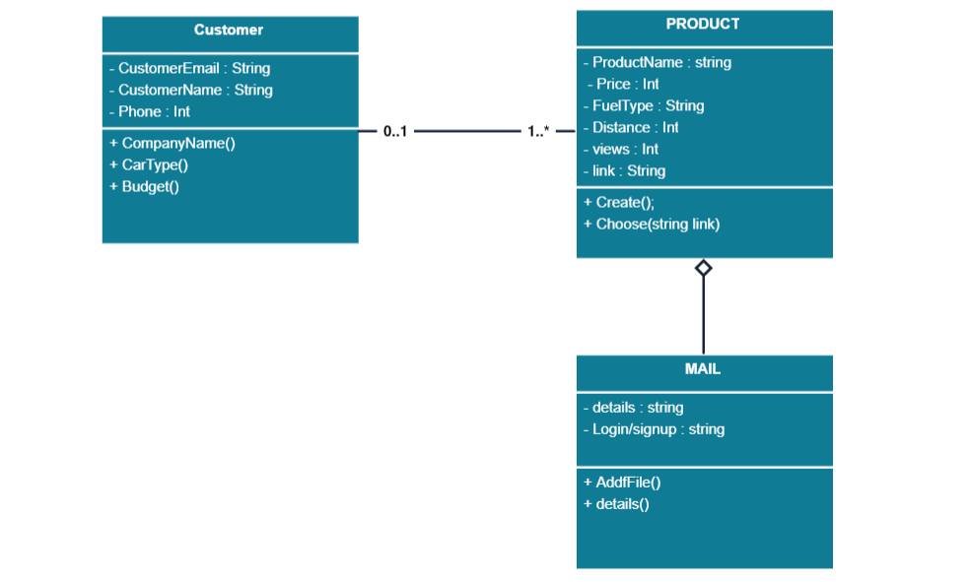
Class diagram

Slide 20
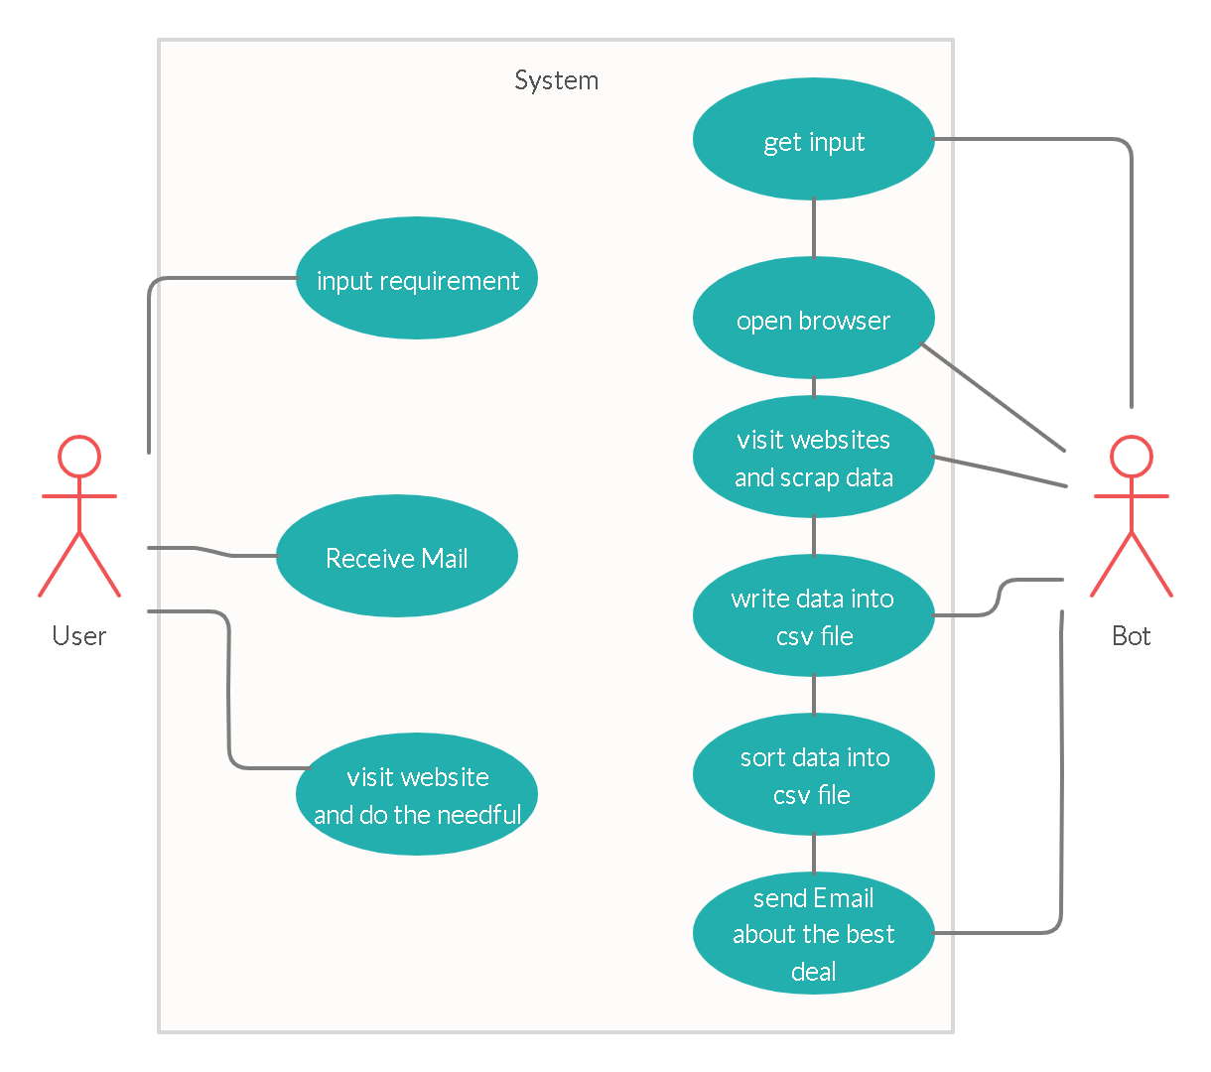
Use case diagram

Slide 21
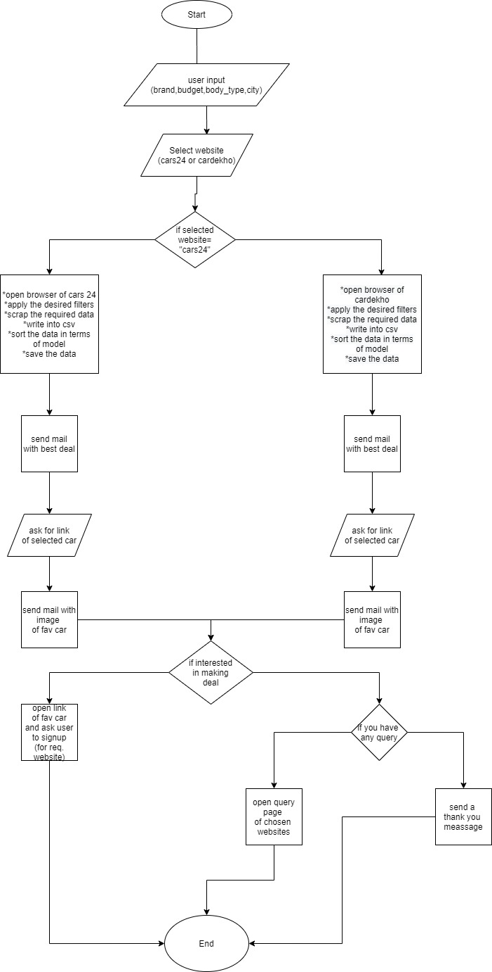
flowchart

Slide 22
Continued..

Slide 23
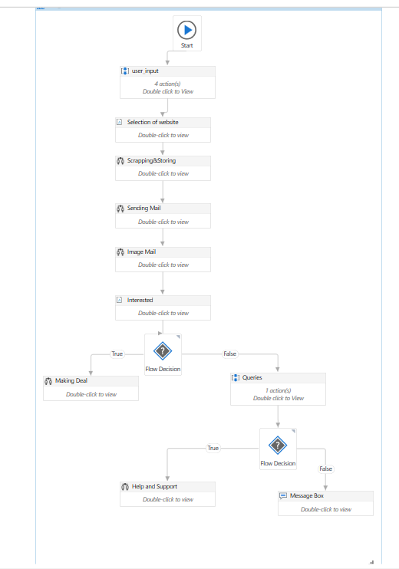
workflow

Slide 24
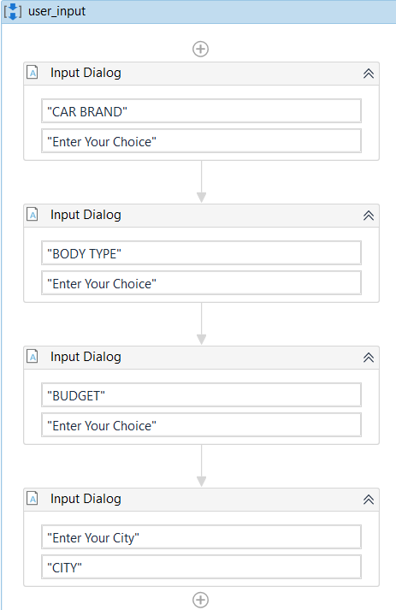
User details

Slide 25
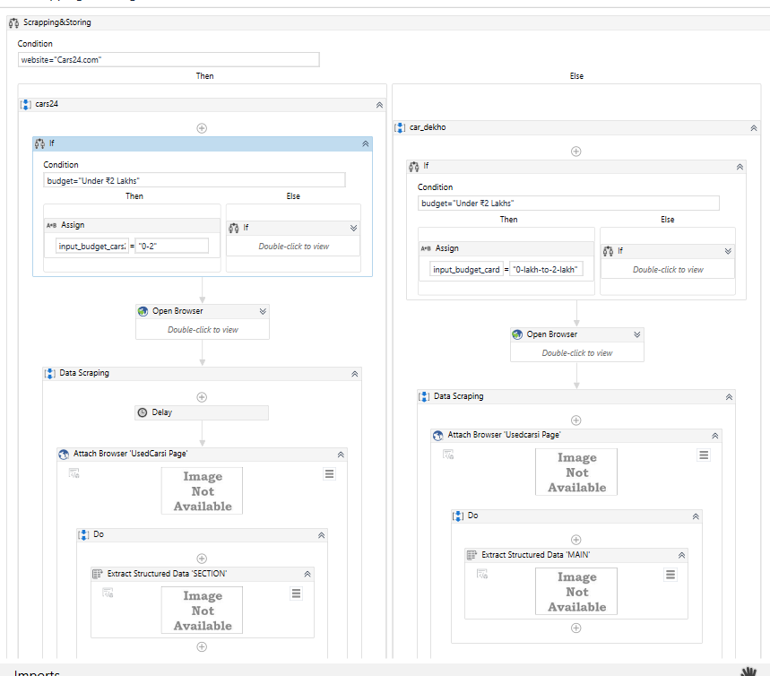
Scraping and storing

Slide 26
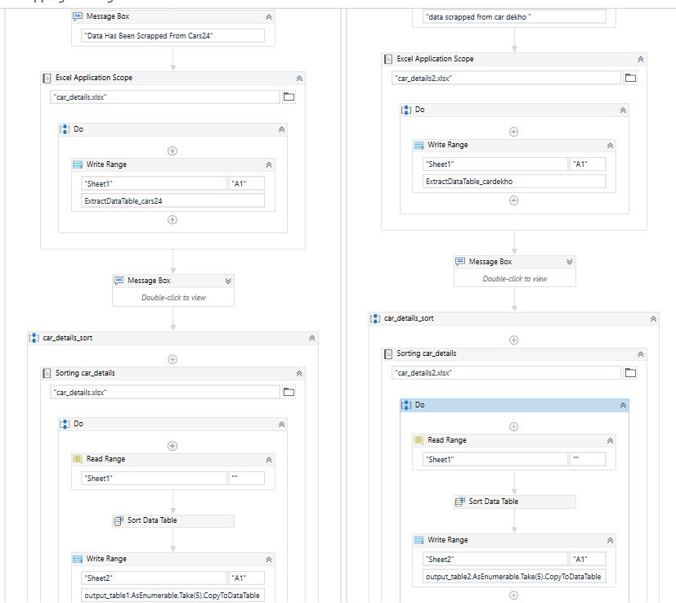
Continued..

Slide 27
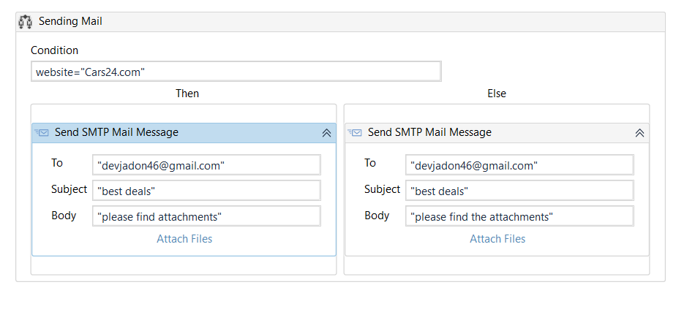
Mailing scrapped data

Slide 28
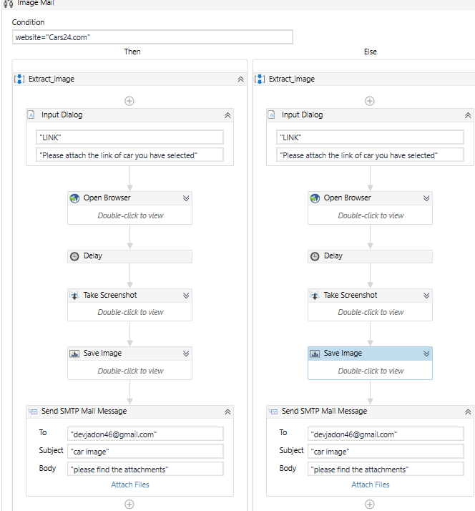
Mailing image

Slide 29
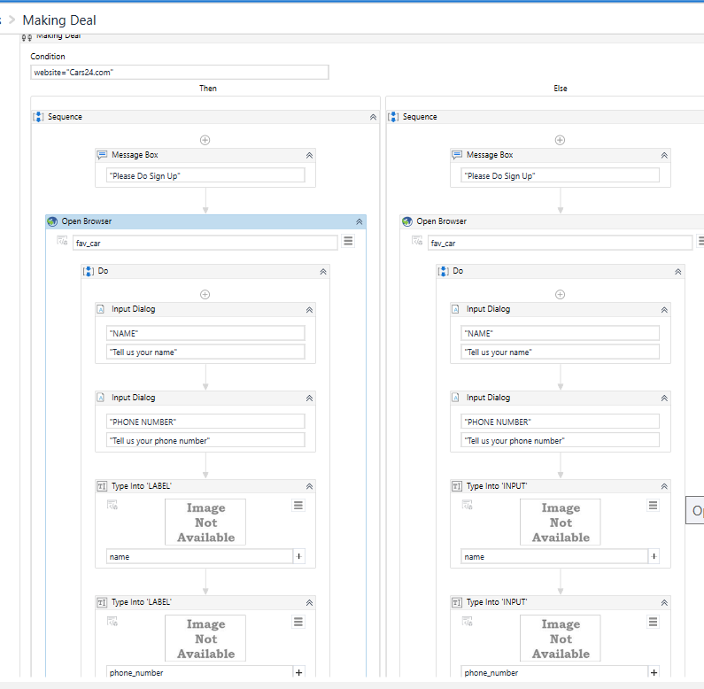
signup

Slide 30
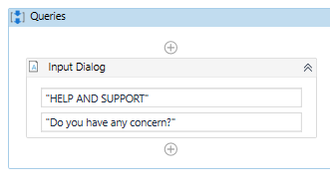
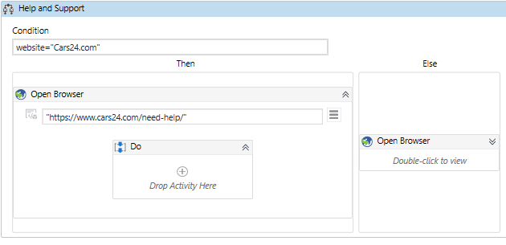
Help and support

Slide 31
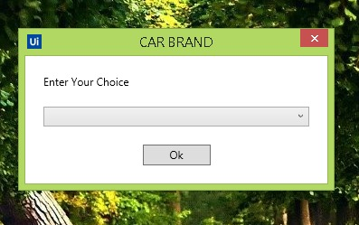
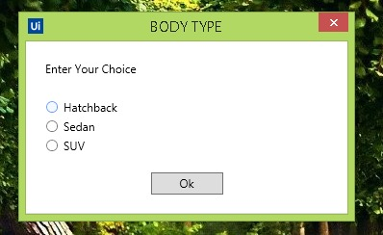
Personal details

Slide 32
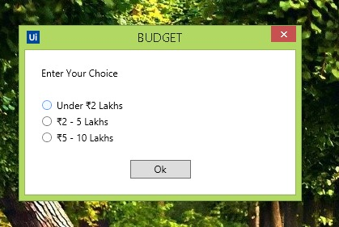
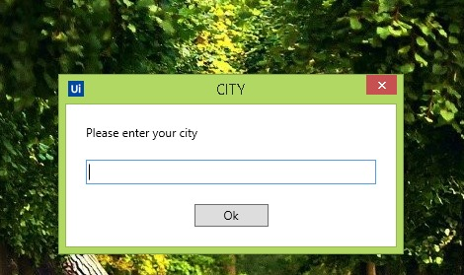
Personal details

Slide 33
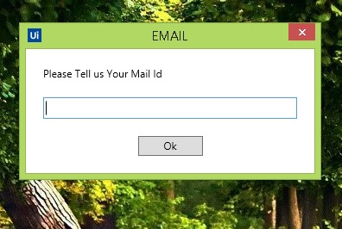
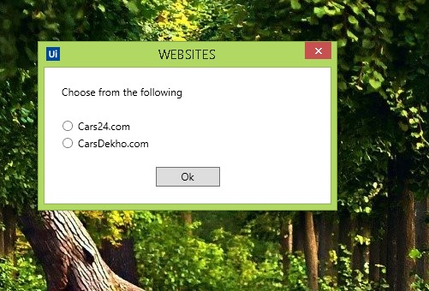
Personal details

Slide 34
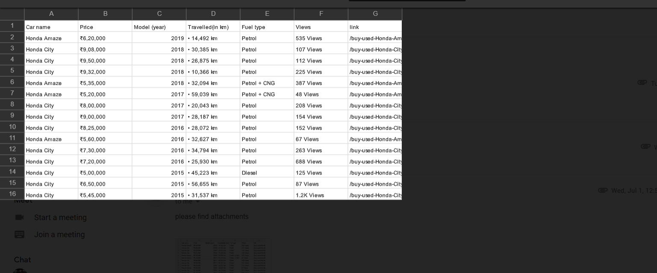
mail

Slide 35
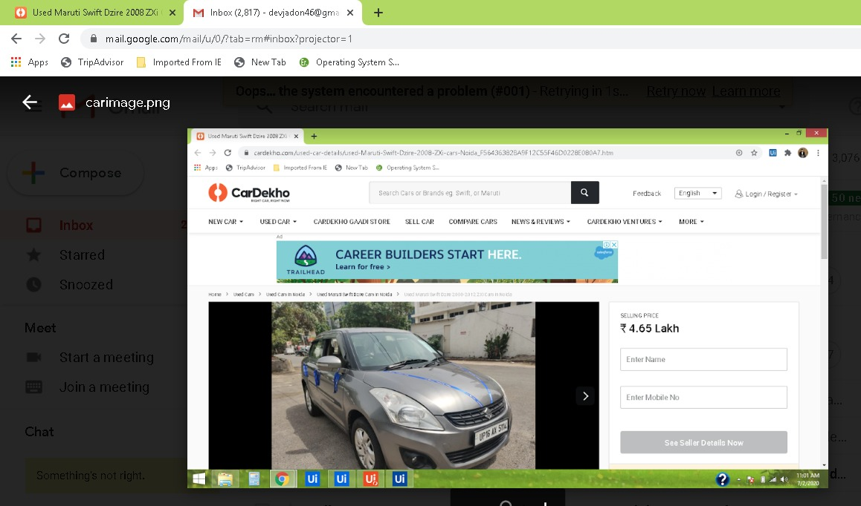
mail

Slide 36
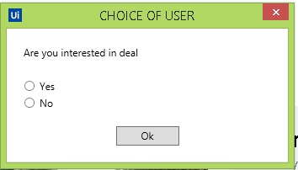
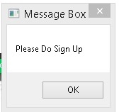
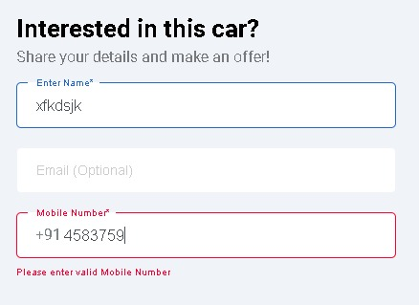
login/signup

Slide 37
Websites used

Slide 38
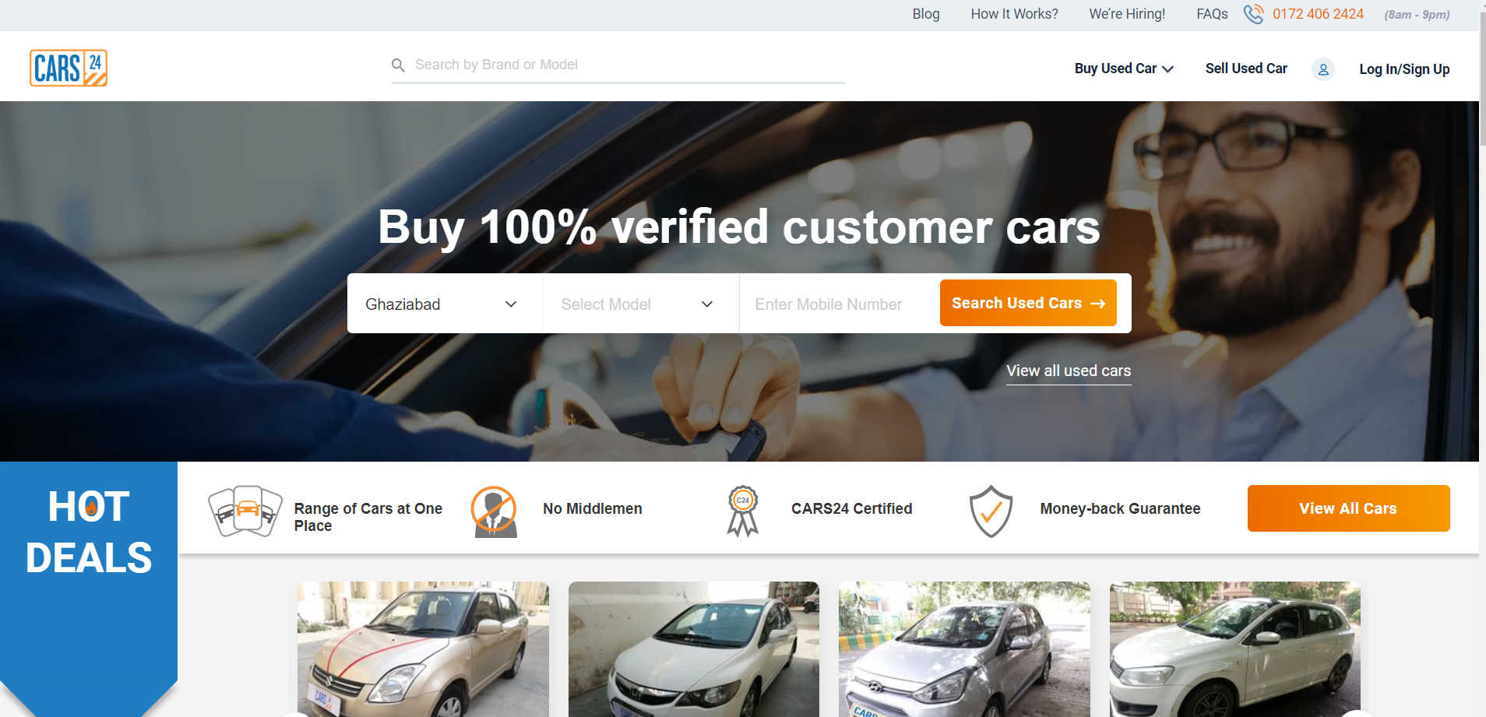

Slide 39
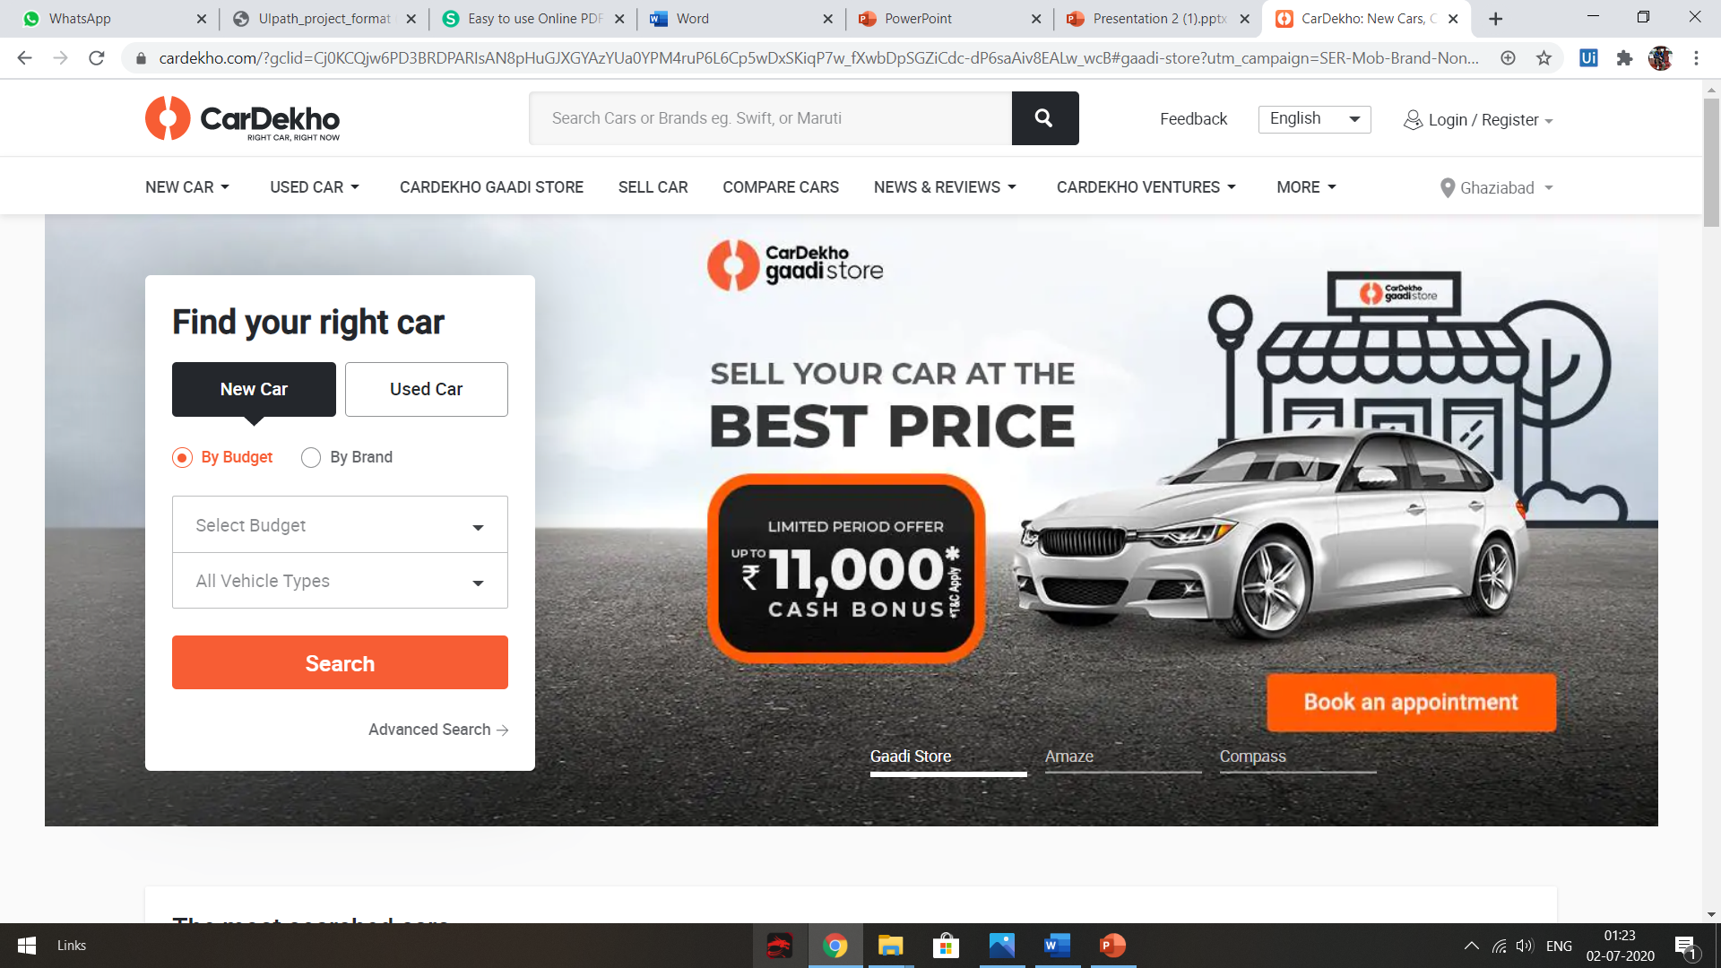

Slide 40
conclusion
This project will help us to save both money and time as the automation will extract data from websites and show all the data to the customer so that the customer can choose accordingly and also go for best deal. By using this the customer won't have to spend hard time in searching through different websites.

Slide 41

Thank You

